Slide 1
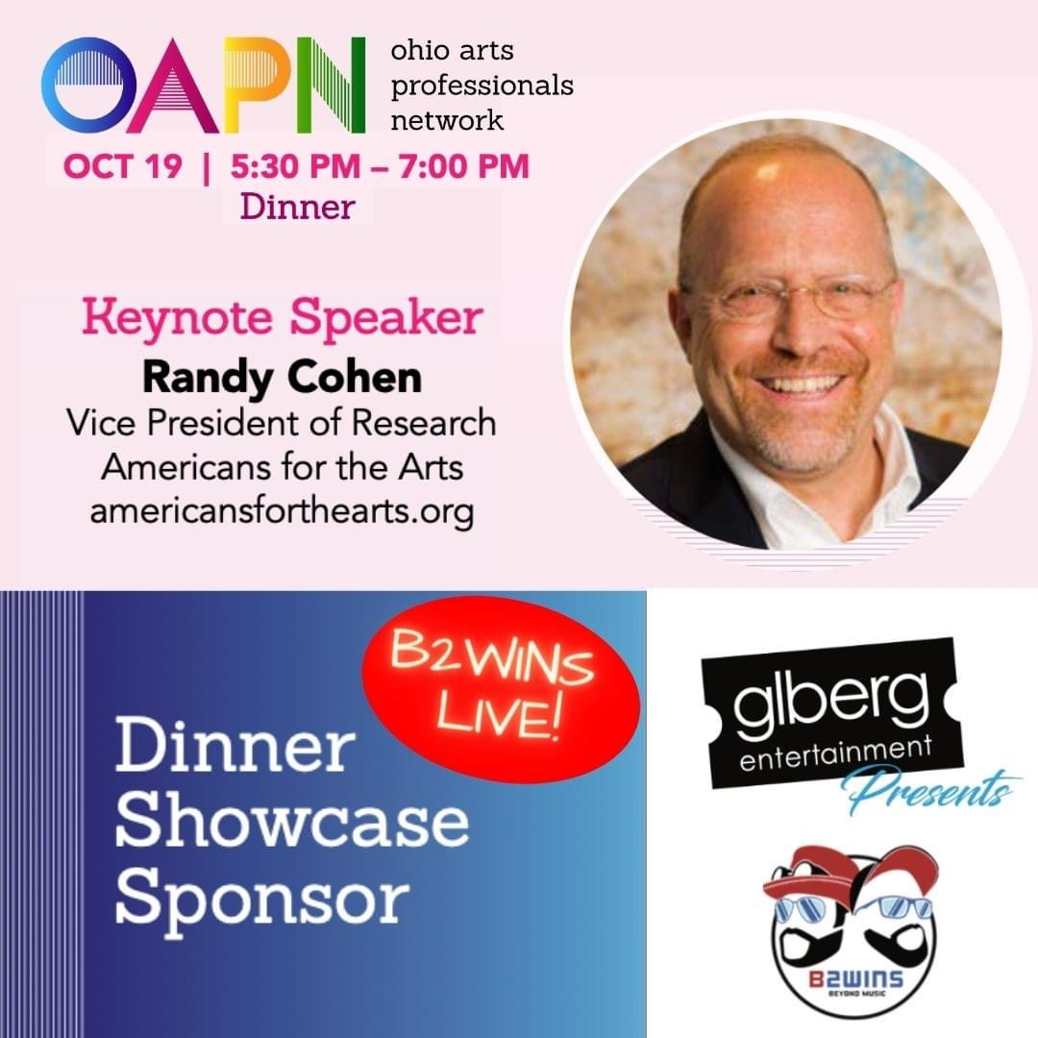

Slide 2
The Rebuilding Power of the Arts in Ohio
Ohio Arts Professionals Network
Cleveland Conference
October 19, 2021
Randy Cohen
Americans for the Arts
@ArtsInfoGuy
Notes:
Change the conversation about the arts.
https://www.americansforthearts.org/2020/03/23/10-reasons-to-support-the-arts-in-2020

Slide 3
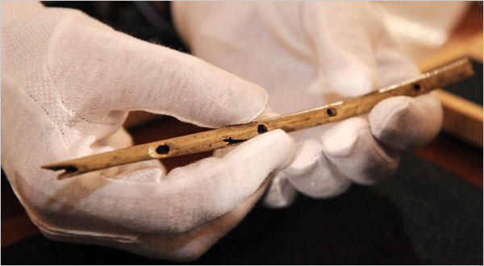
Stone-Aged Flute

Slide 4
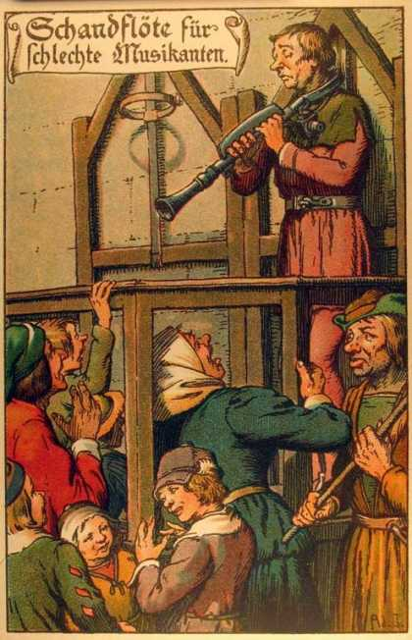
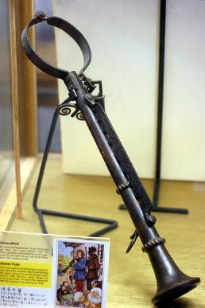
The Shame Flute

Slide 5
Impact of COVID-19 Crisis on the Arts

Slide 6
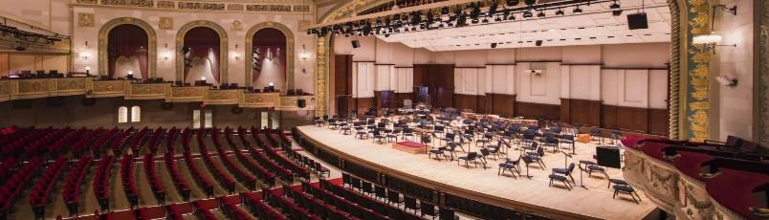
Pandemic and the Arts
Recovery (Happening, Lagging)
Nonprofit employment: arts vs. all
(-14.8% vs. -4.5%)
Arts biz most likely to take 6 months to recover (Census Bureau)
Arts jobs (-53% to -13%)
Impact (Outsized)
99% of org’s cancelled events
63% artist unemployed at 2020 peak
BIPOC artists had higher rates of unemployment and lost income
In-Person Audiences to Performing Arts
38% now attending (up from 17% in April)
Additional 30% expecting to by January 2022

Slide 7
COVID-19 Pandemic Recovery Through the Arts
Strengthen the Economy
Promote Social Cohesion

Slide 8
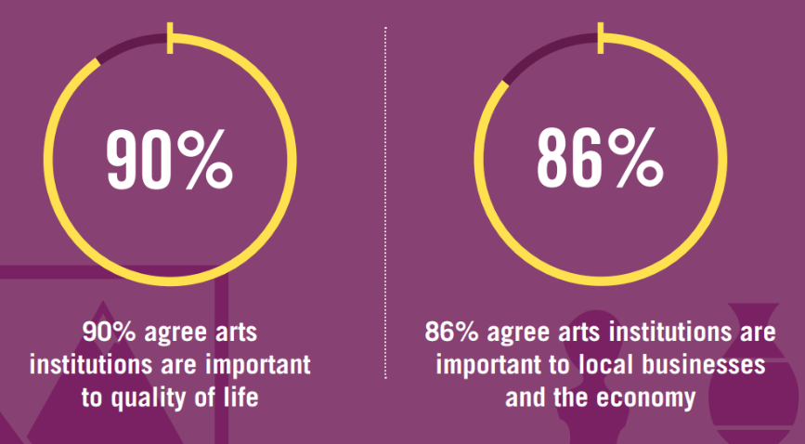
Americans Value The Arts

Slide 9
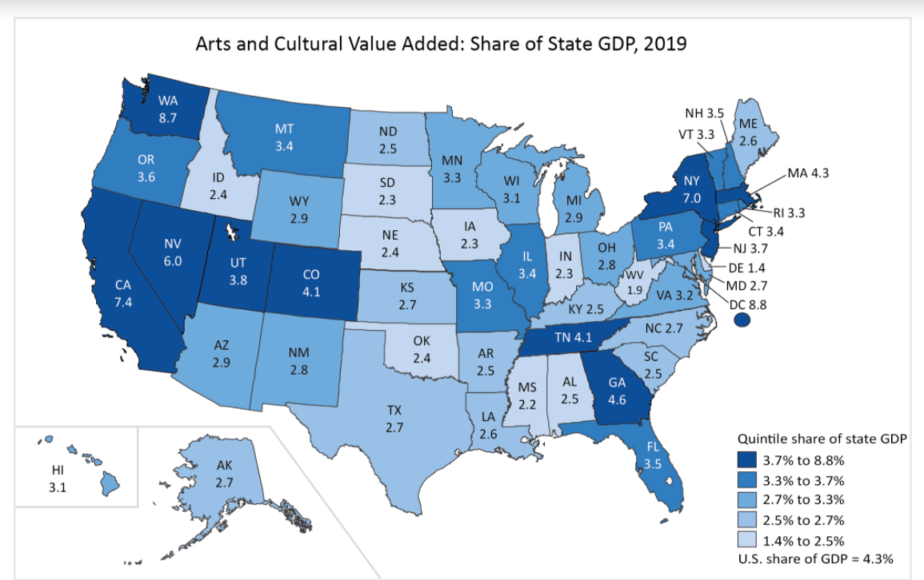
Arts Contribution to the Ohio Economy
$19.6 Billion
2.8% of GSP
172,442 Jobs
US: $919.7 Billion (4.3% of GDP), 5.2 million jobs.
Source: U.S. Bureau of Economic Analysis

Slide 10
National Findings
@ArtsInfoGuy
#AEP5
Notes:
AEP5 changes the conversation about the arts from that of a “charity” to one about an “investment in an industry” that provides both cultural and economic benefits to the community.
We’ve heard this story many times since we published our first economic impact study in 1994—probably why the number of study areas has grown from 33 in that first study to 341 in AEP5. And, why in our national surveys of LAA leaders, economic impact remains the #1 case making argument for arts funding.
We must always remember the fundamental benefits of the arts. They inspire, delight, and unite us. Art is a fundamental component of our humanity. I want to stipulate those benefits and challenge you to think of the arts as an industry—one that supports jobs, generates govt. revenue, and is a cornerstone to tourism.
“How can a group of arts organizations stimulate the economy?” (Tell a personal arts spending story that demonstrates how many industries benefit from arts spending.)

Slide 11
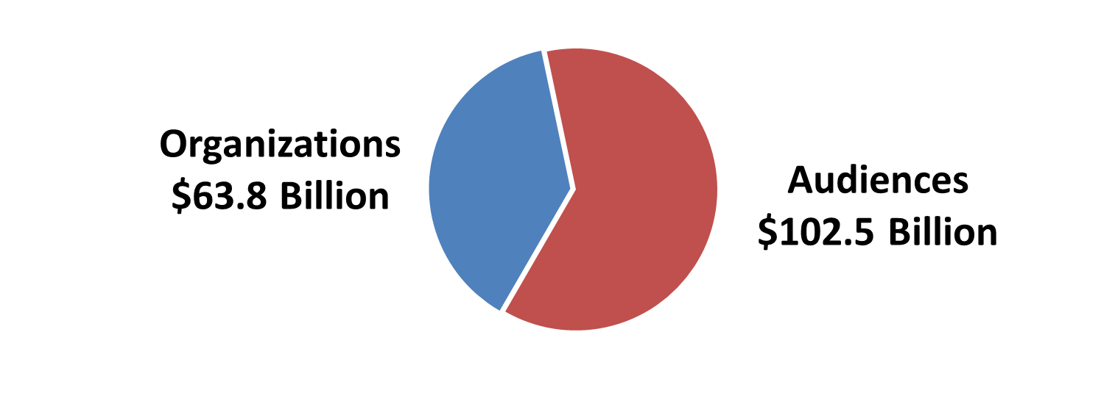
$166.3 Billion in Spending
Notes:
Total economic activity. Composed of two figures—spending by nonprofit arts and cultural organizations and the event-related spending by their audiences. This is an increase from $135 billion in 2010
Nonprofit arts and cultural organizations spent an estimated $63.8 billion in 2015. This is a myth buster for people. Sure, we appreciate the beauty of the arts, but most folks don’t realize that these are businesses. They employ people locally, purchase goods and services within the community, are members of the Chamber of Commerce, and involved in the marketing and promotion of their regions. Arts organizations are good business citizens.
What is the economic impact of that spending?

Slide 12
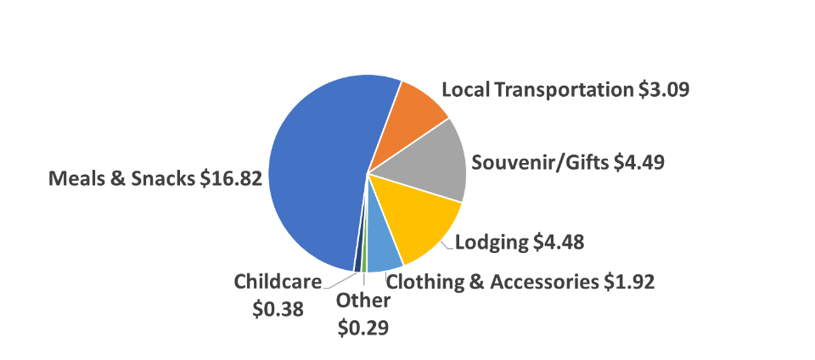
Attendees Spent
$31.47 Per Person, Per Event
Notes:
LIKE all industries, spending by arts organizations has a measurable economic impact. UNLIKE most industries, the arts generate a bounty of event-related spending for local businesses—dollars that land in the pockets of local business establishments such as parking garages, restaurants, retail stores, hotels, and even the local babysitters.
We did 212,691 audience surveys. This is what the average spending looks like.
Can you still get a room for $4.48?? (Remember, these are averages)
When you interview 212,000 people, you are going to hear some great stories. My favorite in the “Other” category is a farmer who paid someone $60 to milk his cows so he could go to the theater.

Slide 13
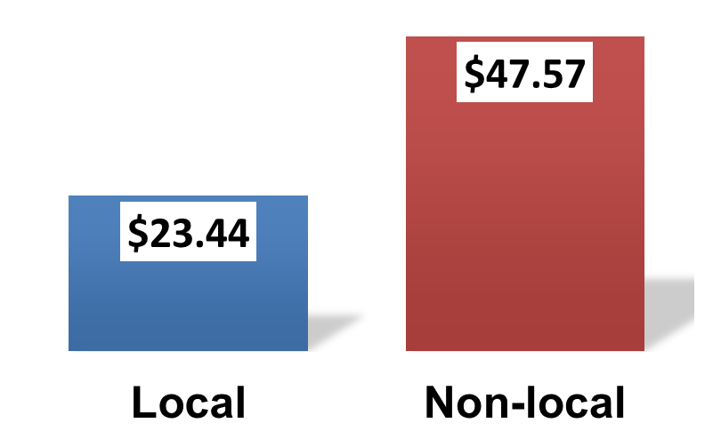
Event-Related Spending
Local vs. Non-Local
69 percent of non-local attendees said, “This arts event is the primary purpose for my trip.”
Notes:
Nonlocal attendees spend $47.57 per person, per event, not including admission—more than twice as much as their local counterparts.
We asked non-local attendees, “Why are you here?” 69 percent said, “This arts event is the primary purpose for my trip.”
We asked local attendees about what they would have done if the arts event that they were attending was not taking place: 41 percent said they would have “traveled to a different community to attend a similar arts event.”
Of the 34 percent of arts attendees who are nonresidents, Nationally, 14 percent reported an overnight lodging expense. They average $169.06 per person. When you can get those “heads in beds,” that is when the cash registers start to ring.
These data show the power of the arts draw visitors into their community, and these people spend money. It also shows that the arts keep locals and their discretionary spending in the community. That is why we say a vibrant arts community is good for local businesses. (Putting “cheeks in seats” and “derrieres in café chairs” ☺.)
(For this analysis, only one night of lodging expenses is counted toward the audience expenditure, regardless of how many nights these cultural tourists actually stayed in the community. This conservative approach ensures that the audience-spending figures are not inflated by non-arts-related spending.)

Slide 14
Jobs Supported (FTE)
4.6 Million
Notes:
Arts organizations employ more than just artists, curators, and musicians. They also pay builders, plumbers, accountants, printers, and occupations spanning many industries.
Remember that our economic analysis measures jobs supported throughout the community.
Because arts organizations are strongly rooted in their community, these are jobs that necessarily remain local and cannot be shipped overseas. (Even in a global economy, arts remain local employers)
Arts . . . Not just food for the soul, but putting food on the table for 4.6 million households

Slide 15
Government Revenue
(Federal, State, Local)
$27.5 Billion
Notes:
Government receives an estimated $27.5 billion in revenue every year as a result of the economic activity of nonprofit arts organizations and their audiences.
This is an outstanding yield given that their collective outlay is about $5 billion. Small Investment. Big return.
Currently there are threats against nonprofits because of the mistaken assumption that they only take, but don’t give back. This study shows that beyond their public benefit, there is also a significant economic return as a result of their investment. Arts funding to nonprofits is not a one-way street.

Slide 16
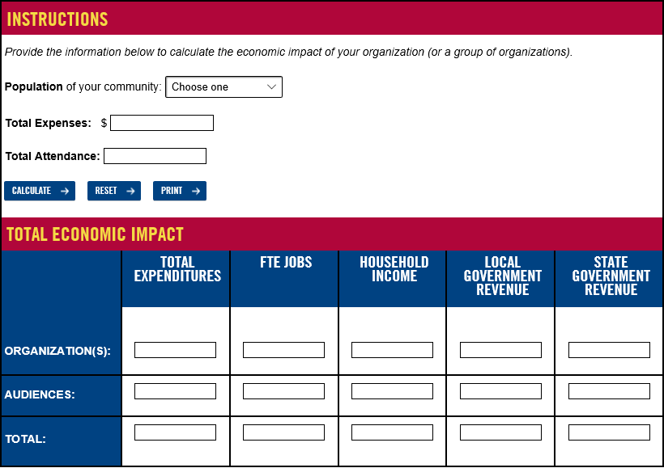
The AEP5 Calculator
www.AmericansForTheArts.org/EconomicImpact

Slide 17
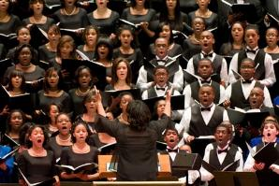

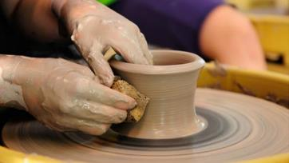
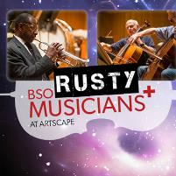
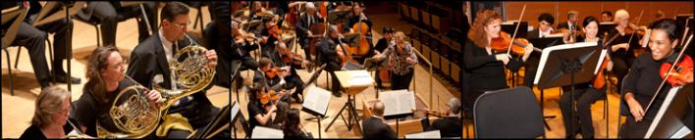
Half of Americans Are
Hands-On Arts Makers

Slide 18
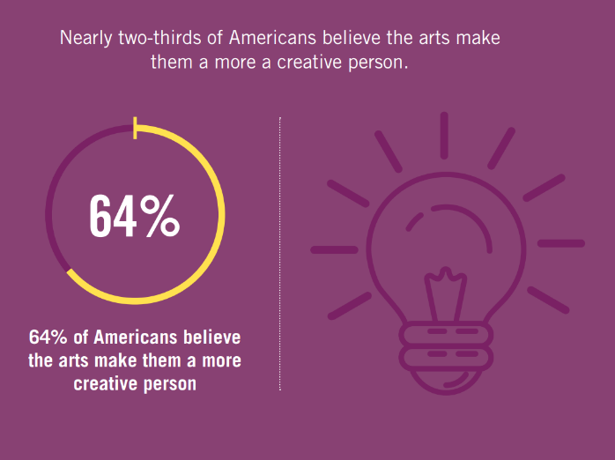
The Arts Make Us Feel Creative!

Slide 19
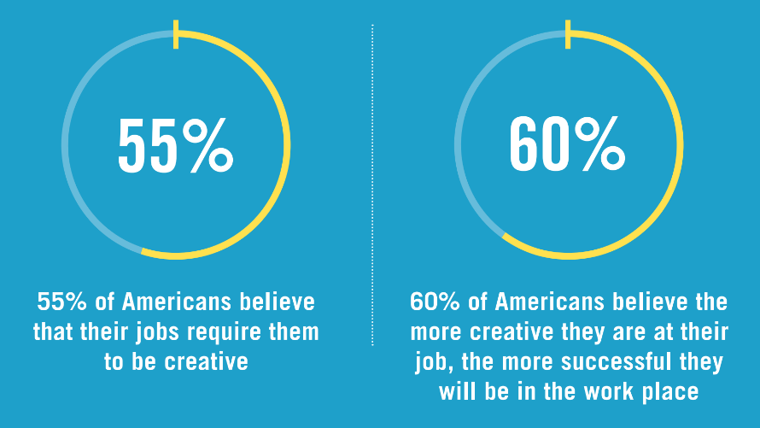
Our Jobs Require Creativity
@ArtsInfoGuy

Slide 20

Thomas Südhof
2013 Nobel Prize for medicine:
“I owe it all to my bassoon teacher”
Drive for excellence…visual thinking…pattern recognition…problem solving…perseverance

Slide 21
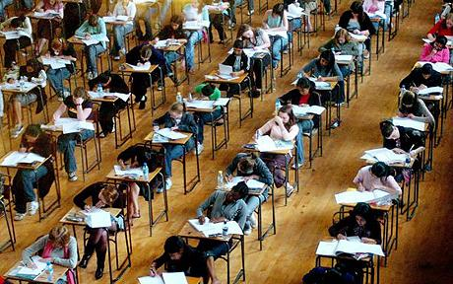
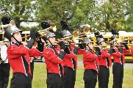

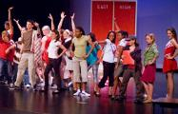
Improved Academic Performance
Notes:
CATTERALL . . .
The academic benefits of arts education go beyond math and reading. An analysis of U.S. Department of Education data by UCLA research James Catterall found that students who were highly involved in the arts performed better on a variety of academic measures than other students (grade point averages, standardized test score, lower drop-out rates, and better attitudes about community service . . . these findings also held when studied across socio-economic strata, suggesting that the arts can "level the playing field" for youngsters from disadvantaged circumstances.
Don’t take my word for it. In a recent commentary in Education Week by Arkansas Governor Mike Huckabee and former U.S. Secretary of Education Rod Paige, they write, “The arts instill in students the habits of mind that last a lifetime: critical-analysis skills, ability to deal with ambiguity and to solve problems, perseverance, and a drive for excellence.”
Now, it's hard to argue with these facts, but policy makers have found ways to ignore them. Too many of our students in our communities and classrooms simply don't have access to arts education. Last year’s report by the Council of Basic Education documented, via surveys of 1,000 school principals, what so many of us are observing. Because of No Child Left Behind laws, our schools are teaching to the test more than ever, and cutting out the liberal arts. 25 percent of the principals reported decreases in instructional time for the arts; 33 percent anticipate future decreases in instructional time.

Slide 22
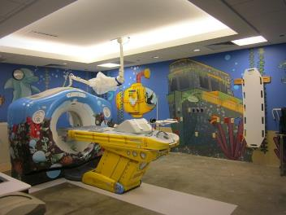
Arts in Healthcare Benefits
Reduced length of hospital stay
Fewer medical visits
Reduced use of pain and anxiety med’s
Improved recovery time
Reduced depression
Strengthens mental health
@ArtsInfoGuy
Notes:
In a national survey about arts programs in hospitals, more than half of the 2,000 responding hospitals indicated having on-site programming for their patients and staff. The reasons are many, but 73 percent present the arts because it aids in a patient’s mental and emotional recovery.
Arts programs in hospitals serve multiple audiences: 96 percent are designed to serve patients directly; 56 percent include the patient’s family members; and 55 percent include programs for staff, as a means to deal with the stress in the healthcare environment.
Hospital arts programs are largely funded by the hospital itself—66 percent of their budgets come from the hospital’s general fund. These programs are often conducted in partnership with local performing and visual arts organizations, or their local arts agency.
Survey conducted by Joint Commission on Accreditation of Healthcare Organizations, Americans for the Arts, and Society for Arts & Healthcare.

Slide 23
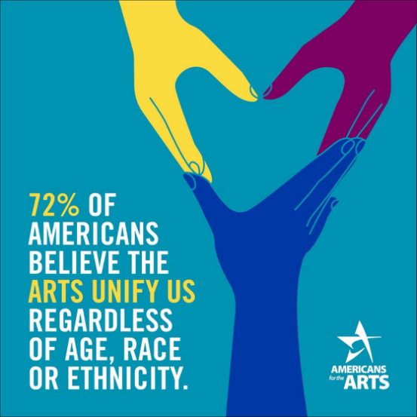
The Arts Unify Communities
@ArtsInfoGuy

Slide 24
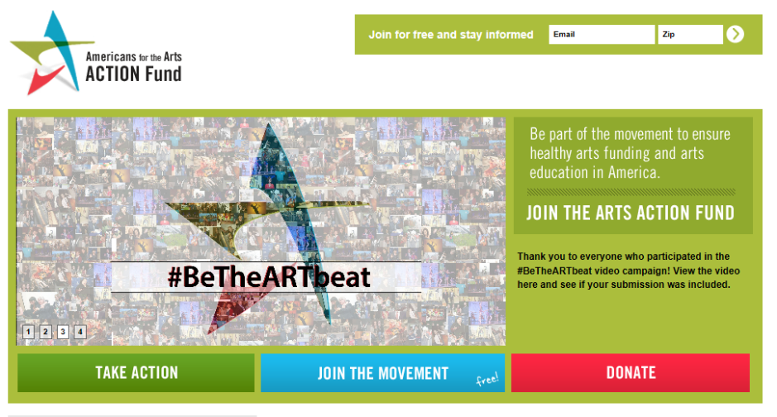
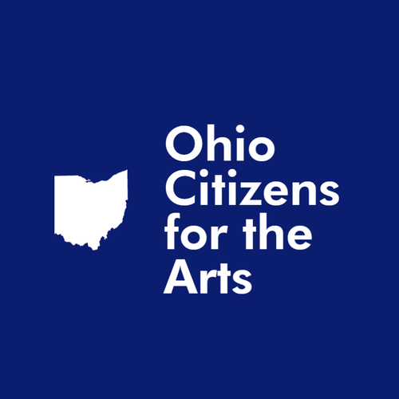
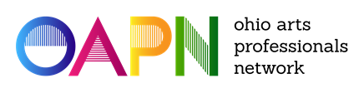
We All Have a Job to Do!
Notes:
Angela P. Meleca | Executive Director
Ohio Citizens for the Arts

Slide 25
1. What is the message?
2. Who gets the message?
3. Who delivers the message?
Golden Rule: No story without a number, and no number without a story!
Claim Your Impact!
Arts are on the right side of what this country needs!
@ArtsInfoGuy

Slide 26
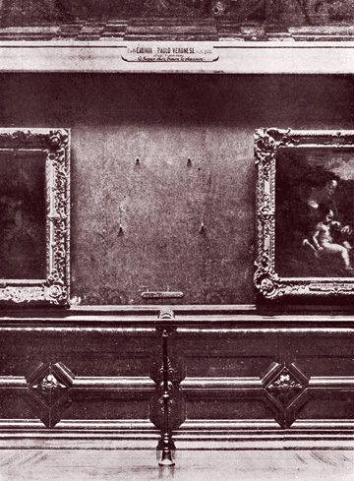
Appreciating The Arts

Slide 27
Thank You! www.AmericansForTheArts.org rcohen@artsusa.org
@ArtsInfoGuy

Slide 29
How to Make the Case for Arts Funding
(Who is your target market?)
Elected Officials
Economic impact, community development & arts education
Business Leaders
Economic impact, benefits to business & community development
Private Funders
Arts education, improving quality of life & community livability
Individual Donors
Arts education, quality of life & “arts for arts sake”

Slide 30
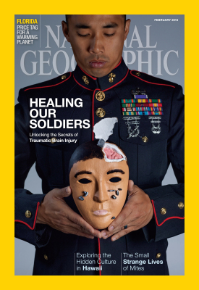

Arts & Healing in the Military
@ArtsInfoGuy

Slide 31
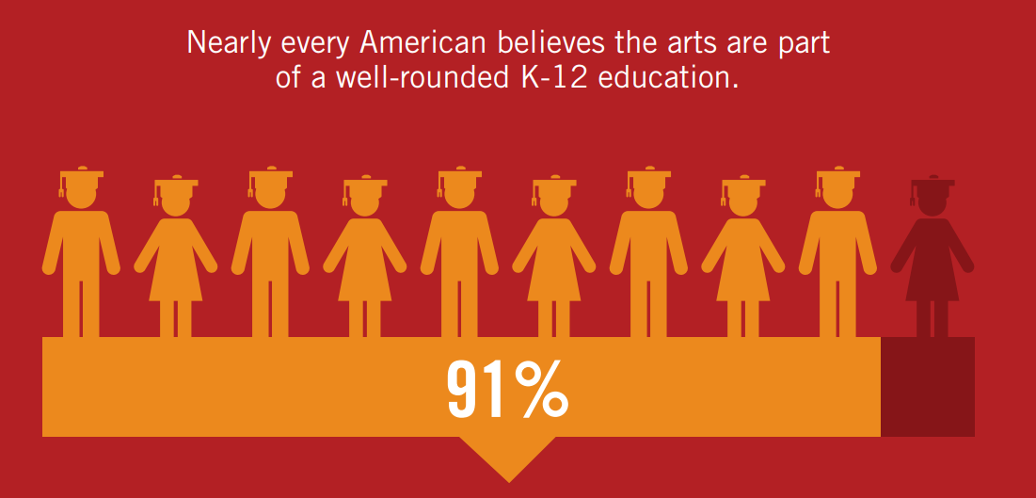
Americans Believe the Arts are Part of a
Well-Rounded Education for K-12 Students
@ArtsInfoGuy

Slide 32
Notes:
The 2008, the Conference Board published, Ready to Innovate touts the importance of arts education in building the 21st century workplace. Arts participation in the school or in the workplace strengthens our “creativity muscles” which builds our creativity, the fuel that drives innovation.
72% of employers say creativity is of primary concern when they’re hiring, and 85% of these employers can’t find the creative applicants they seek.
Employers who replied to the survey believe creativity has less to do with finding solutions than with the ability to spot problems or patterns others cannot see.
Arts-related study in college is a key creativity indicator to potential employers.
Very few employers test for creativity in the hiring process; a noteworthy 27 percent said they use the candidate’s appearance to assess creative ability.
The Conference Board report concludes, “..The arts—music creative writing, drawing, dance—provide the skills sought by employers of the Third Millennium.

Slide 33
“Everyone in my community has equal access to the arts.”
(Just 50 percent of the public agrees)
A Call for Action

